Slide 1
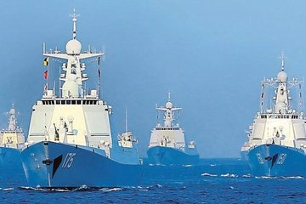
Invisible War in South China Sea

Slide 2
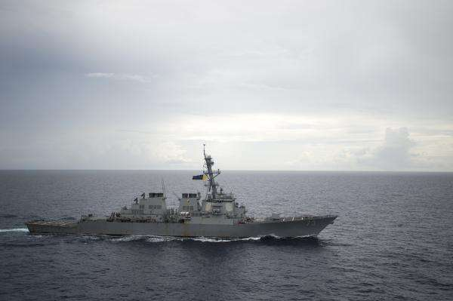
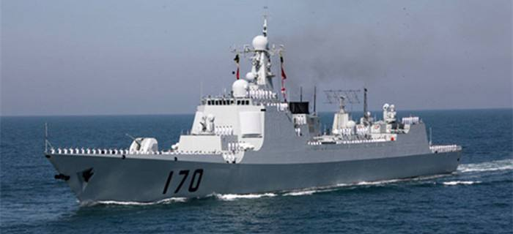
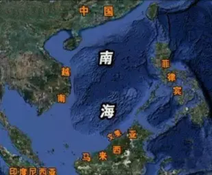
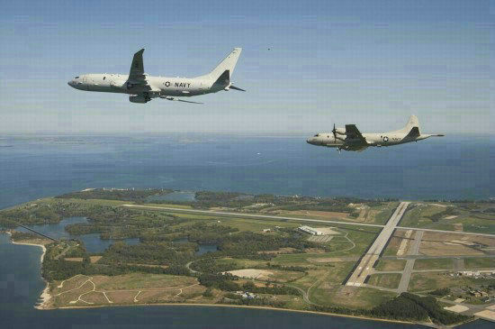
What happened in South China Sea?

Slide 3
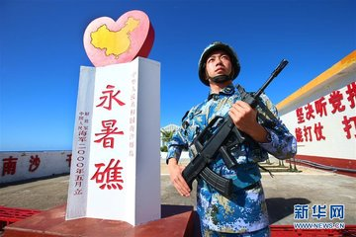
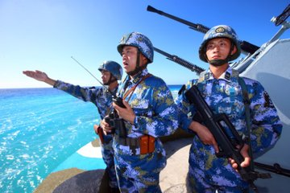
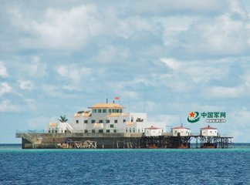
Mini-discussion
1. Why is the US so keen in harassing the South China Sea?
2. What can we do to secure our little islands there?
3. What will happen in the future?

Slide 4
News reading questions
who is the real troublemaker in South China Sea?
What disgusting action is the US conducting?
What causes US to carry out such kind of action?
The US.
Freedom of navigation mission.
It’s following “America first” policies.

Slide 5
Group discussion: What can we do?
1. Our country should…
2. We citizens should…

Slide 6
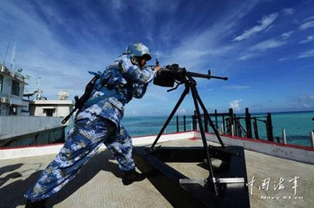
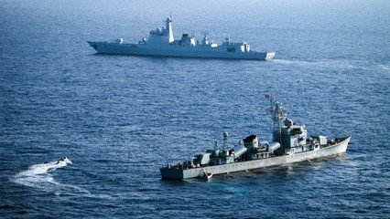
Group discussion: What can we do?
1. Our country should…
Strength our defense systems on the little islands.
Our navy forces as well as air forces should work together.

Slide 7
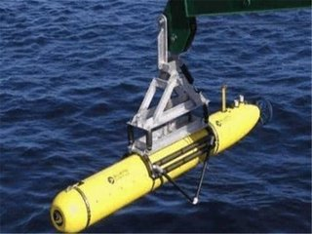
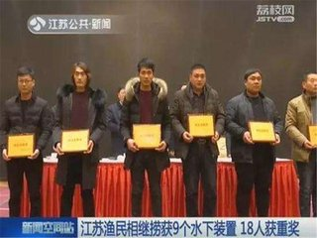
Group discussion: What can we do?
2. Our citizens should:
Work with the army to defend our sea.
Hand in suspicious foreign gadgets to the army.
….

Slide 8
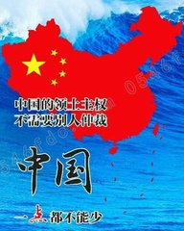
Look ahead: What will happen in the future?

