Slide 1
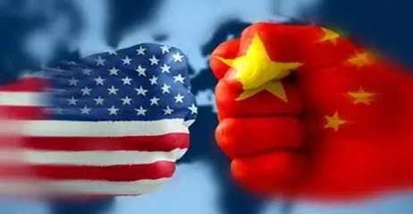
A Glimpse of Sino-US Trade War
中美贸易战

Slide 2
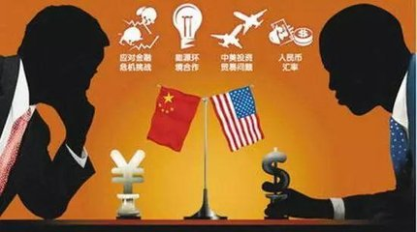
How much do you know about the Trade War?
Learning goals:
1. Who started it first? What are the purposes?
2. What are possible consequences?
3. What can China do in reaction?

Slide 3
Present situation of the trade war
Watch a video clip and complete the missing information.
1. The US will impose a $ __________ new tariffs on products from…, accounting for ______ of everything China sells….
2. China is to tax an additional $ _________ worth of goods from...
Summary of the present situation:
As we can learn from the news, …
200 billion
half
In return
for this
60 billion
What conclusions can we draw about the trade war?
more fierce and in larger scales--- escalating, more worries

Slide 4
Summary of the present situation
As we can learn from the news, the trade war between China and US is escalating, with US taxing $200 billion on Chinese products. In return for this, China will impose tariffs on $60 billion imports from the US, causing more worries about the future trade relations between China and the US.

Slide 5
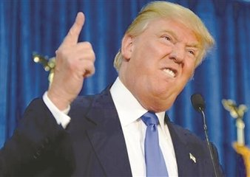
Why does the US start it
Read the news report and find out the reasons.

Slide 6
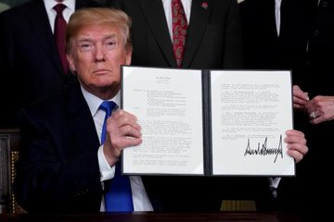
First Reading questions—read the lines
1. Who wrote this news brief?
2. What did he charge China with?
US President, Donald Trump
Para.5 As President, it is…
Para.2: …China is engaged in numerous unfair policies and practices relating to United States technology and intellectual property.

Slide 7
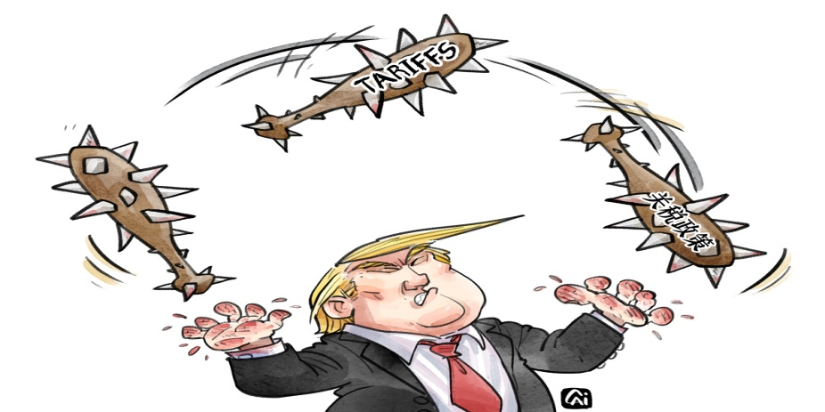
Second reading—read between lines
1. What will US do if China takes retaliatory action?
What is the purpose of his saying this?
What is the US really worried about?
Pursue phase 3, tariffs on $267 billion of additional imports.
To threaten China to submit to the US.
China’s technology is developing fast constituting threat to long-term health and prosperity of the US economy.
‘America First’ Policy

Slide 8
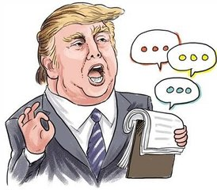
Third reading—read beyond lines
What image does Trump try to establish before Americans?
2. What kind of person do you think Trumps is? Why?

Slide 9
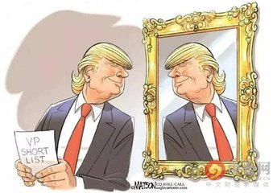
Third reading—read beyond lines
What image does Trump try to establish before Americans?
Very tough towards China
Para.1…Further, if China takes retaliatory action, we will immediately pursue phase three, which is tariffs ….
Para.6. …Once again, I urge China’s leader…
Very caring about ordinary Americans
Para.5 As President, it is my duty to protect the the interests of working men…My Administration will not remain idle when…

Slide 10
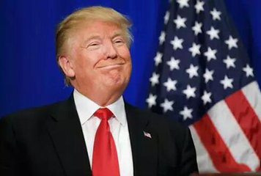
Third reading—read beyond lines
2. What kind of person do you think Trump is? Why?
Arbitrary, aggressive and bullying: charging China randomly; starting the trade war and escalating it crazily.
Hypocritical: He didn’t mean what he said, by saying:
Para.6…and president Xi of China, for whom I have great respect and affection.
So what?
I don’t care!

Slide 11
Consequences of trade war
Watch the video clip and answer the question: what will happen to the US consumers’ life?
Their life will be a little more expensive.
What else will be affected?

Slide 12
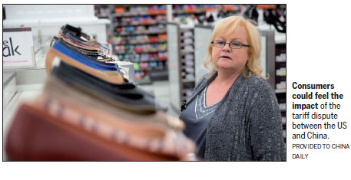
Consequences of trade war
Read the news and answer the questions:
1. What does the underlined word sting mean in the first paragraph?
2. What consequences are mentioned?
3. What is the purpose of this piece of news?
a sharp pain
Retail prices moving up; retail industry hurt; supply chains restructured.
A warning to the US consumers
and retail industry.

Slide 13
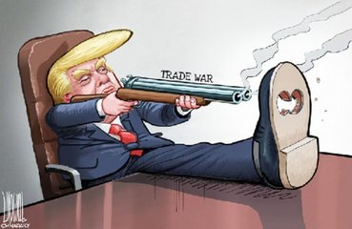
Consequences of trade war
Mini-discussion:
How will the trade war affect us?
Sales of Chinese goods in the US will decrease.
Some factories may be closed and workers may lose jobs.
American products will be more expensive.
In conclusion, both …and …will suffer from…
Therefore, trade war is like a __________________.
double-edged sword

Slide 14
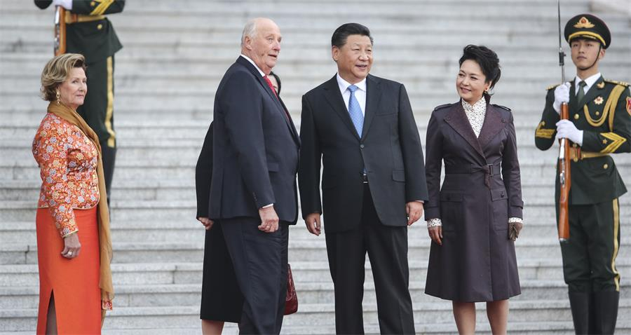
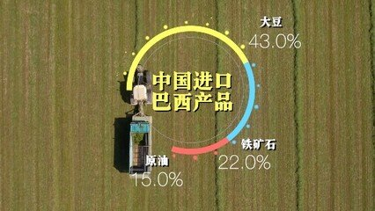
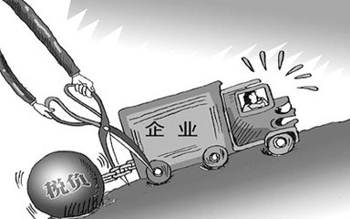
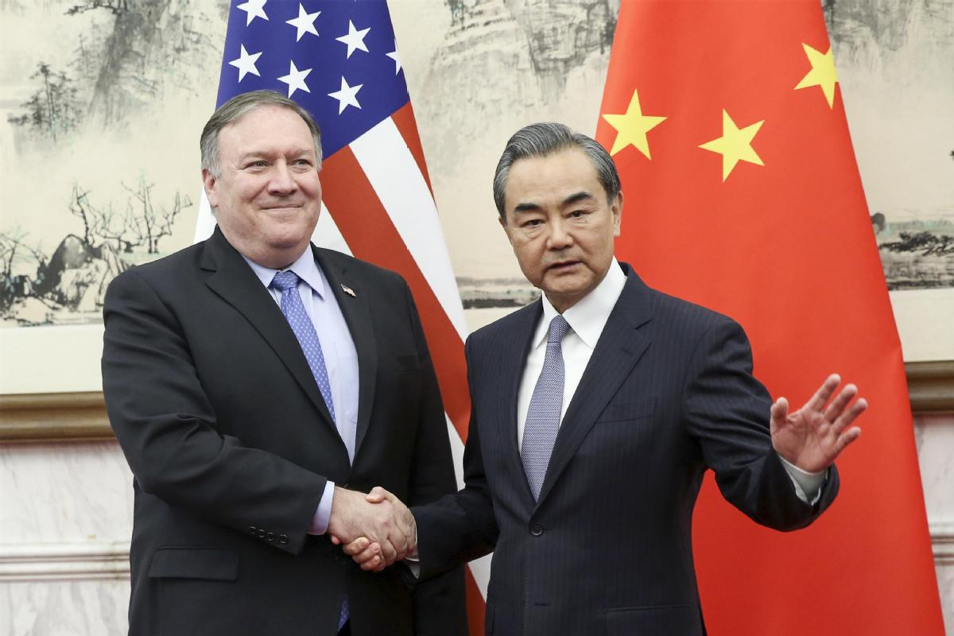
Picture News: possible solutions
What can we do to defeat Trump’s conspiracy?

Slide 15
Possible solutions
Strengthen relationship with other countries, enhancing trade with them and enlarge the alternative exporting market.
Import substitute products from other countries like Brazil.
Reduce the tax burden of domestic factories to help them become more competitive and dynamic.
Make US understand that cooperation is the only way out.

Slide 16
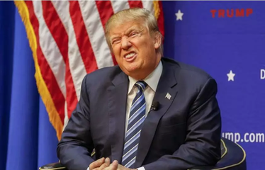
Let’s recall what we have learned
Present situation of the trade war.
Causes of the trade war.
Consequences of the trade war.
Solutions to the trade war.
Writing assignment:
Write a short essay, including the above 4 aspects, entitled A Glimpse of Sino-US Trade War.

Slide 17
Some more ideas to share
1. China is not going to negotiate with a gun pointed to its head.
2. Talking is the only way for US and China to solve the conflict.
3. Look to the future; make responsible decisions.
4. History shows cooperation is the best policy.

